Slide 1
CSE 2451 Bitwise Operations
Zichen Zhang

Slide 2
Overview
Binary representation of integers
Underflow & overflow
Fixed width integer types in <stdint.h>
Bitwise operators
Bitwise NOT
Bitwise AND
Bitwise OR
Bitwise XOR
Bit shifting
Bit masking
Notes:
Source:
https://en.cppreference.com/w/c/language/storage_duration

Slide 3
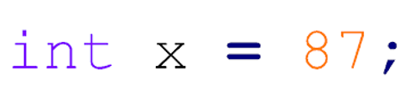
Integer types
The basic integer type is (signed) int
Can have either positive or negative values
The value of an int variable is represented in binary format with 1s and 0s
Integer variable have limited range (due to limited number of bits used in the representation)
Negative numbers’ binary representation is not in C standard (look up Two's Complement)
2⁵
2³
2¹
2⁶
2⁴
2²
2⁰
$$87={1∗2}^{6}+0∗2^{5}+1∗2^{4}+0∗2^{3}+1∗2^{2}+1∗2^{1}+1∗2^{0}$$
00000000,00000000,00000000,01010111
32 bits = 4 bytes

Slide 4
Integer type specifiers
Type | Minimum Size (bits) | Minimum Capacity
short int | 16 | -32,768 to +32,767
int | 16 | -32,768 to +32,767
long int | 32 | -2,147,483,648 to +2,147,483,647
long long int (available in C99) | 64 | -9,223,372,036,854,775,808 to +9,223,372,036,854,775,807
Note that these are minimum sizes, actual ones may be larger
unsigned
unsigned int , unsigned long int …
Can only contain non-negative values
Valid range is doubled

Slide 5
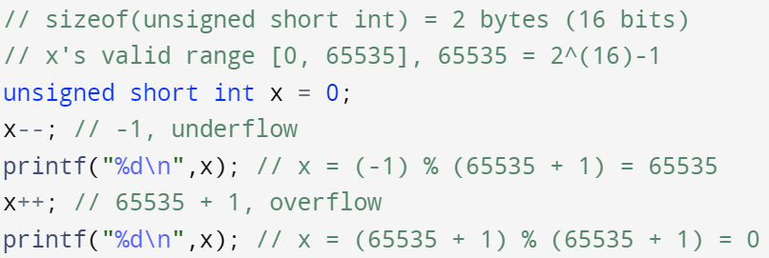
Integer Overflow/Underflow
Integers have limited capacity (maximum and minimum numbers they can contain)
What happens if they go over or under that capacity?
For signed integers, it’s undefined behavior
For unsigned integers: modulo (MAX_VAL + 1) will be performed to bring the value back to the valid range
MAX_VAL is the maximum valid value of the associated unsigned integer type, in this example, it’s 65535

Slide 6
Fixed-width integer types (C99)
stdint.h is a header file in the C standard library introduced in C99
allow more portable code by providing a set of exact-width integer types
The minimum and maximum valid values for each type is also defined with macros
#include <stdint.h>
Fixed-size integer types:
intN_t for signed int, N is number of bits: int8_t, int16_t, int32_t, int64_t
uintN_t for unsigned int: uint8_t, uint16_t, uint32_t, uint64_t
Minimum and maximum:
INT8_MIN, INT8_MAX, …, INT64_MIN, INT64_MAX
UINT8_MAX, …, UINT64_MAX (unsigned type’s minimum is always 0)

Slide 7
Bitwise operations
In C, operations can be performed on a bit-level using bitwise operators
Bitwise operators’ operand must be of integral type, for example:
unsigned int
signed int
long int
char (1-byte integer)

Slide 8
Bitwise Operators
OR |
 | 1 | 0
1 | 1 | 1
0 | 1 | 0
AND &
 | 1 | 0
1 | 1 | 0
0 | 0 | 0
XOR ^
 | 1 | 0
1 | 0 | 1
0 | 1 | 0
NOT ~
1 | 0
0 | 1
Different from the logical operators, these operators work on all bits of numbers simultaneously

Slide 9
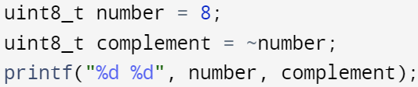

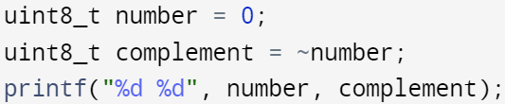

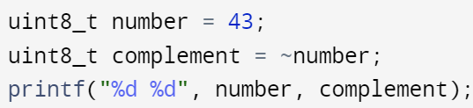

Complement (Bitwise NOT): ~
8=00001000
247=11110111
0=00000000
255=11111111
43=00101011
212=11010100

Slide 10
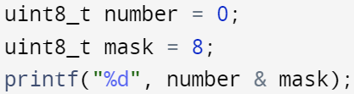
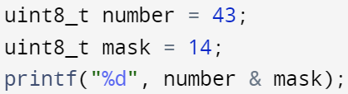
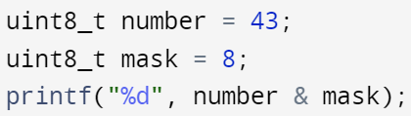
Bitwise AND: &
0=00000000
8=00001000
0=00000000
Bitwise AND operator is often used to acquire the value of certain bits:
e.g., to get the value of 4th bit
We can use a mask with its value set to 8 (only 4th bit is set to 1)
43=00101011
14=00001110
8=00001010
43=00101011
8=00001000
8=00001000

Slide 11
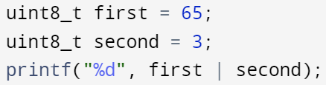
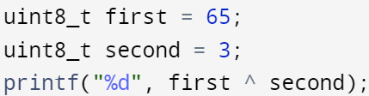
Bitwise OR: |
Bitwise OR operator is often used to set the value of certain bits:
e.g., to set the value of 1st and 2nd bits to 1
We can use a mask with its value set to 3 (only 1st and 2nd bits are 1s)
65=01000001
3=00000011
67=01000011
Bitwise XOR (exclusive OR): ^
65=01000001
3=00000011
66=01000010

Slide 12
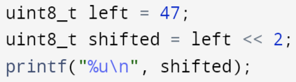
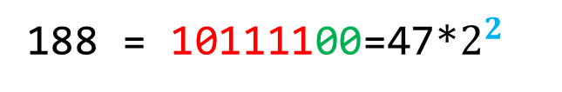
Bit shifting
Binary left shift operator: <<
The left operand’s bits are moved left by the number of bits specified by the right operand
Zeros are padded to the right side
Zero padding
47 = 00101111
188 = 10111100=47*$2^{2}$
188
Right operand value of <<

Slide 13
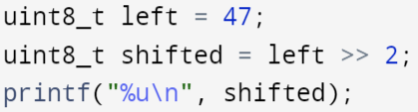
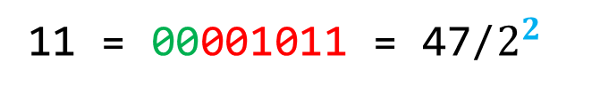
Bit shifting
Binary right shift operator: >>
The left operand’s bits are moved right by the number of bits specified by the right operand
Zeros are padded to the left side
47 = 00101111
11 = 00001011 = 47/$2^{2}$
11
Zero padding
Right operand value of >>

Slide 14
Bit shifting
Negative value for right operand of shifting operator leads to undefined behavior
x << -1
y >> -2
Both << and >> operators are conceptually arithmetic operators equivalent to multiplication or division by the appropriate power of 2
y = x << 3; \\ y = x*2*2*2;
y = x >> 2; \\ y = x/(2*2); \\division between integers with truncation
Try to avoid bitwise operators with signed integer as things get complicated (negative integer values’ binary representation is not specified in C standard)

Slide 15
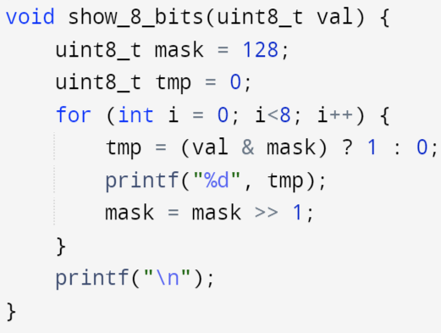
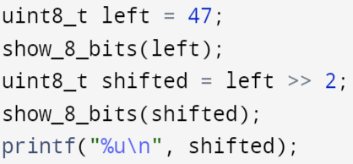
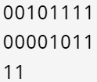
Print out binary values
Use a bit mask to acquire the bit value of the input iteratively
Print 1 or 0 respectively

Slide 16
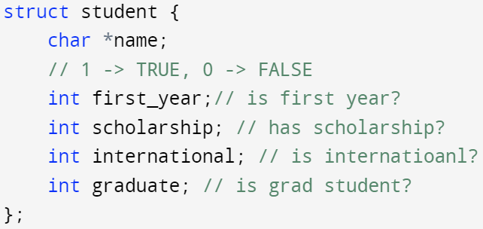
Bit masking
If we want to store a lot of true/false information, how do we do it most efficiently?
The above struct variable takes at least 24 bytes, is there more efficient way to store the information?
Combine the four int members into 1 unsigned int member
Then use bit masking

Slide 17
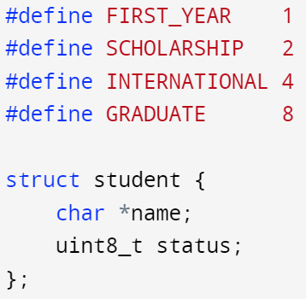
Bit masking
Use different bits to encode information of different aspect
1 = 0000,0001
2 = 0000,0010
4 = 0000,0100
8 = 0000,1000
Bit masks:
Each takes the value that only set one bit to 1
24 bytes = 8 bytes + 4*4 bytes
16 bytes = 8 bytes + 1 bytes + 7 bytes
The last 7 bytes are the zero paddings

Slide 18
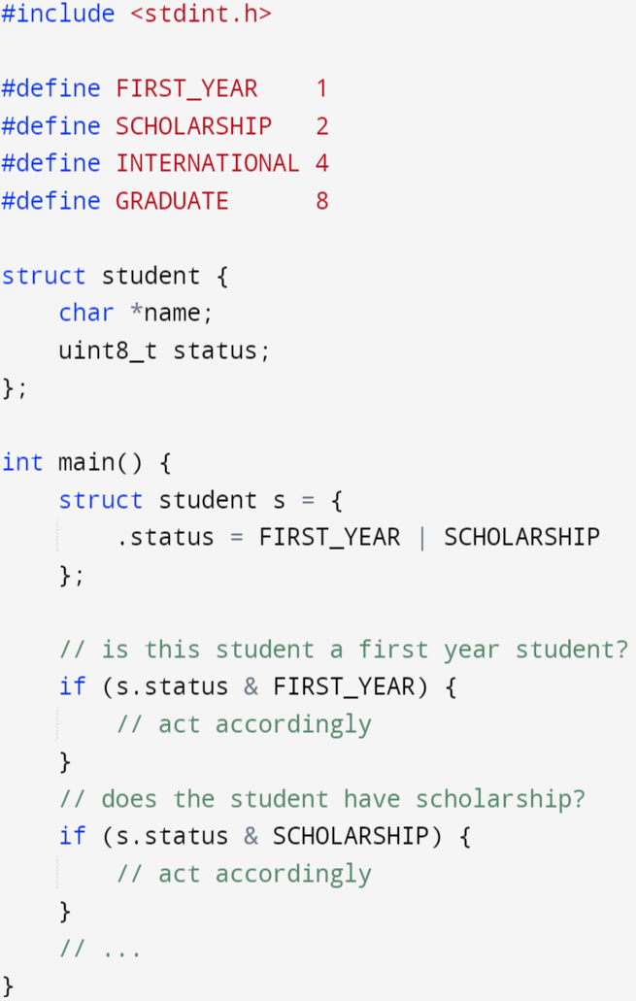
Bit masking
Use bit masks and the & operator to fetch information encoded in the corresponding bit
status & FIRST_YEAR is not zero if and only if the right most bit is set to 1
Status & SCHOLARSHIP is not zero if and only if the 2nd right most bit is set to 1
The same applies to INTERNATIONAL and GRADUATE masks as well

